Slide 1
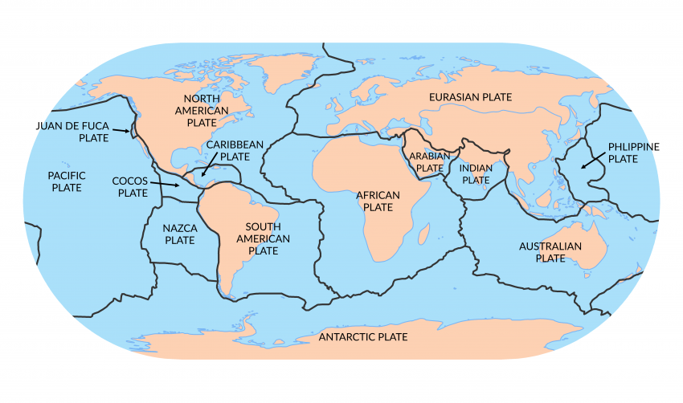
Lesson: Plate Tectonics

Slide 2
ENGAGE

Slide 3
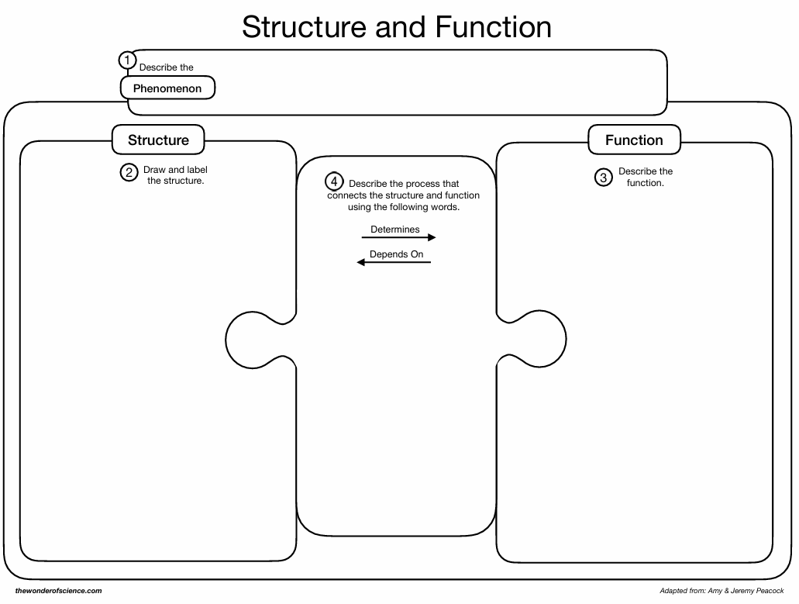
Engage
While viewing the following slides, complete the organizer on how you think these events happen.

Slide 4
Explore
Insert picture of tectonics plates and question how they can move?

Slide 5
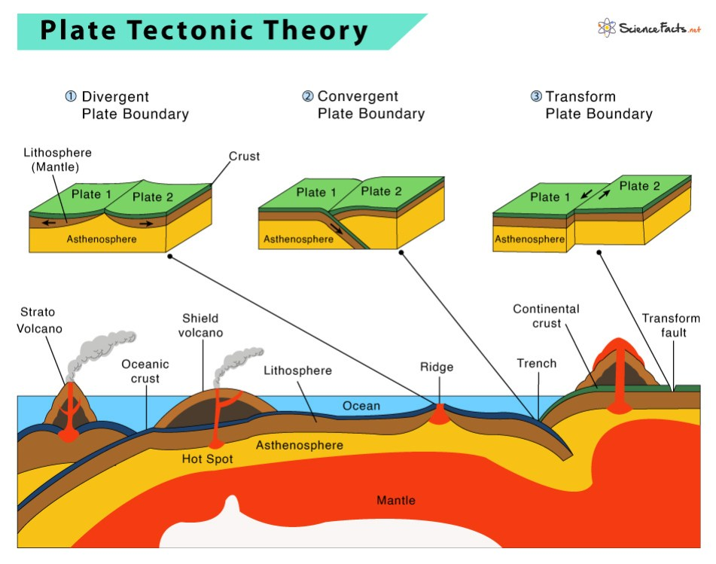
Explore
Insert picture of tectonics plates and question how they can move?

Slide 6
Engage
Discuss your organizer for one minute with your lab partner.
Be prepared to share out

Slide 7
Engage
What is happening on Earth that causes these plates to move?

Slide 8
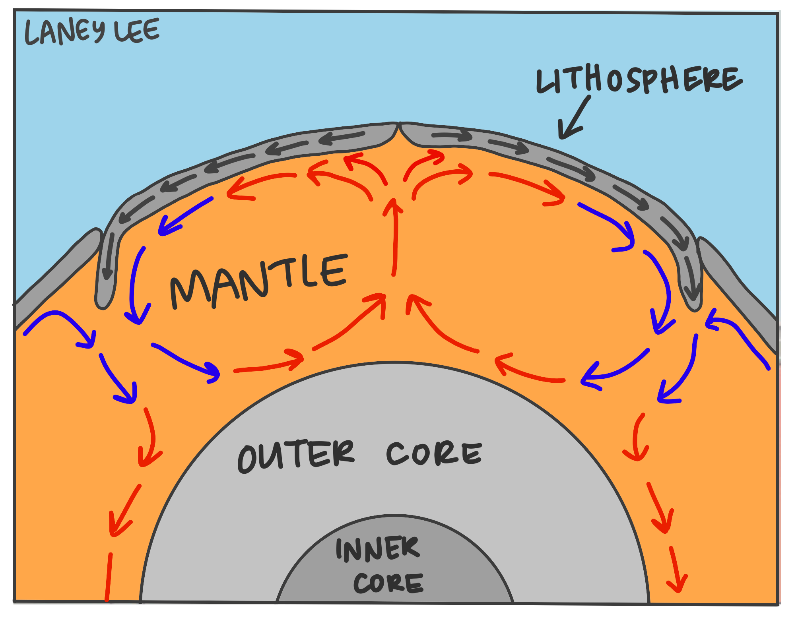
Convection Currents

Slide 9
Explore
Lab: Plate Tectonics

Slide 10
Explain

Slide 11
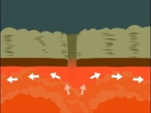
1962 The mechanism forcing continents to move is understood! Harry Hess - Theory of Sea Floor Spreading (Plate Tectonics)

Slide 12
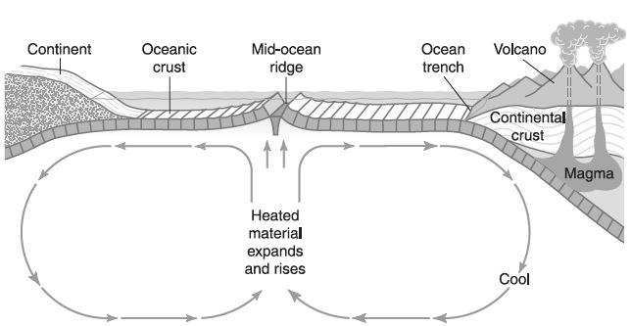
1) How do the plates move?
Convection currents: Driving force behind plate movements caused by the uneven heating of mantle fluids by the Earth’s interior.

Slide 13
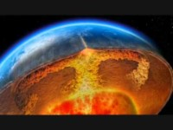
Convection Currents

Slide 14
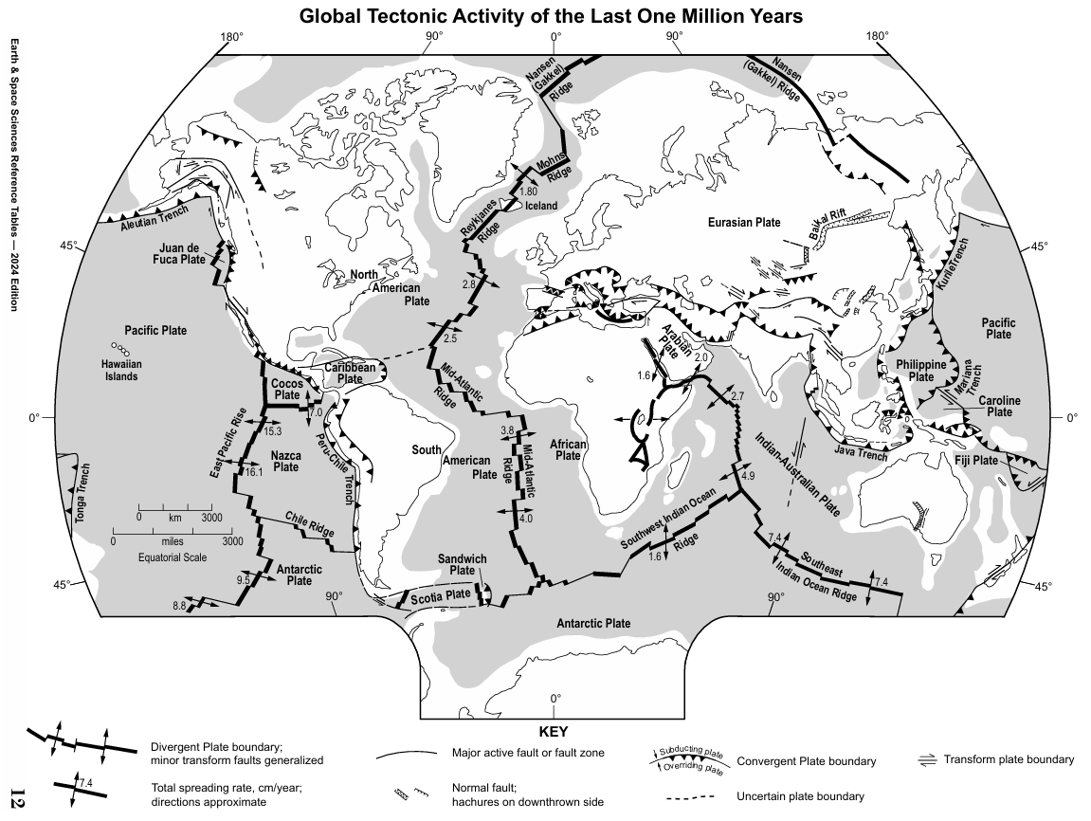
ESRT Page 12

Slide 15
Elaborate

Slide 16
Convection Currents

Slide 17
Evaluate
Quiz/test or similar

